Slide 1

AIDI 2004-02
AI IN ENTERPRISE SYSTEMS
Assignment 3
Flask
Submitted by :
Devangraj Sanjay Vaidya (100780615)
Jugnu Shefin (100814025)
Aleemullah Khan (100846597)
Prof. :
Sajeeva Salgadoe

Slide 2
About the Assignment
Develop RESTful API using Flask and perform CRUD (Create, Read, Update and Delete) operations. The Database developed must have following fields in its table:
student_id
first_name
last_name
dob(date of birth)
amount_due

Slide 3
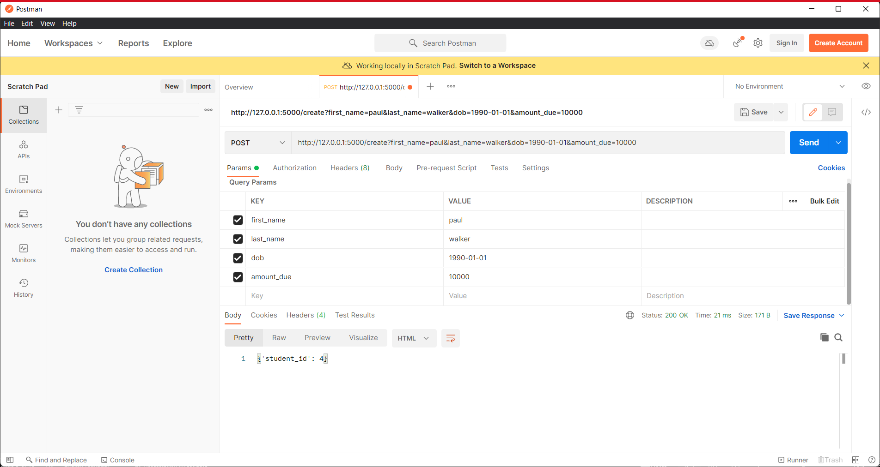
For Create

Slide 4
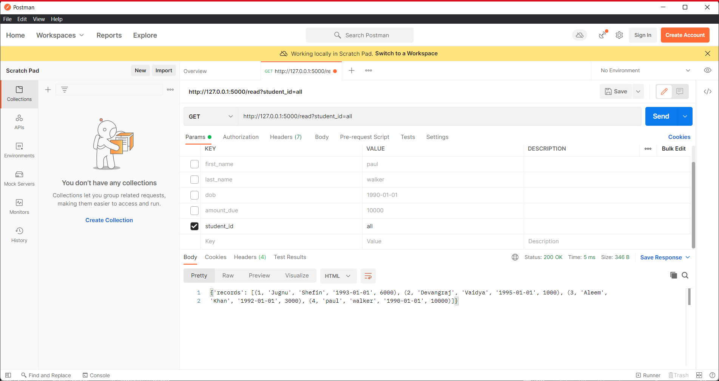
For Read

Slide 5
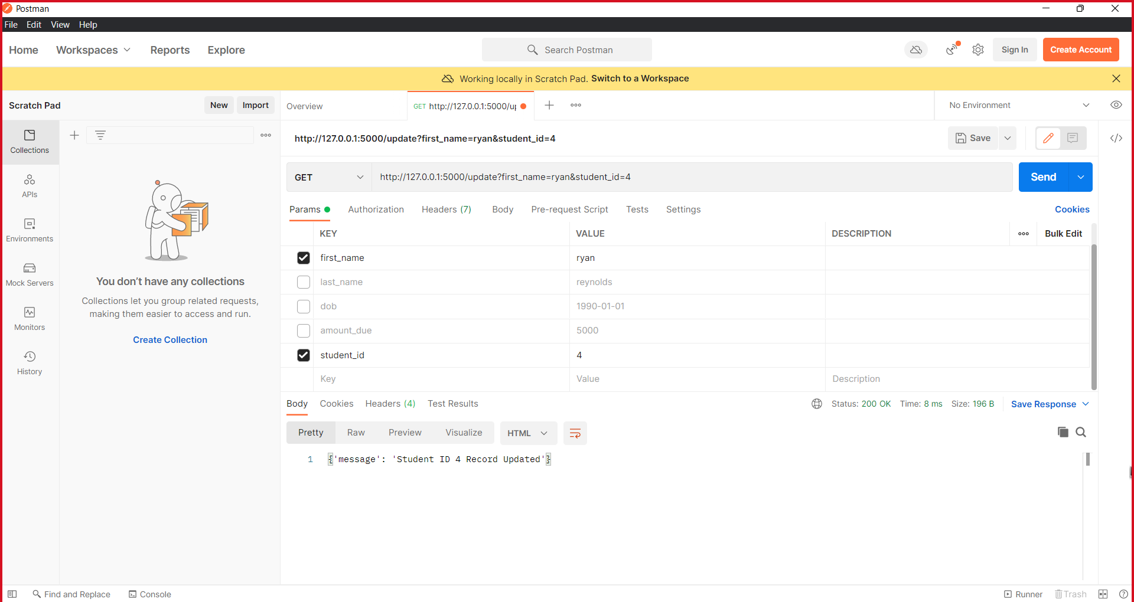
For Update

Slide 6
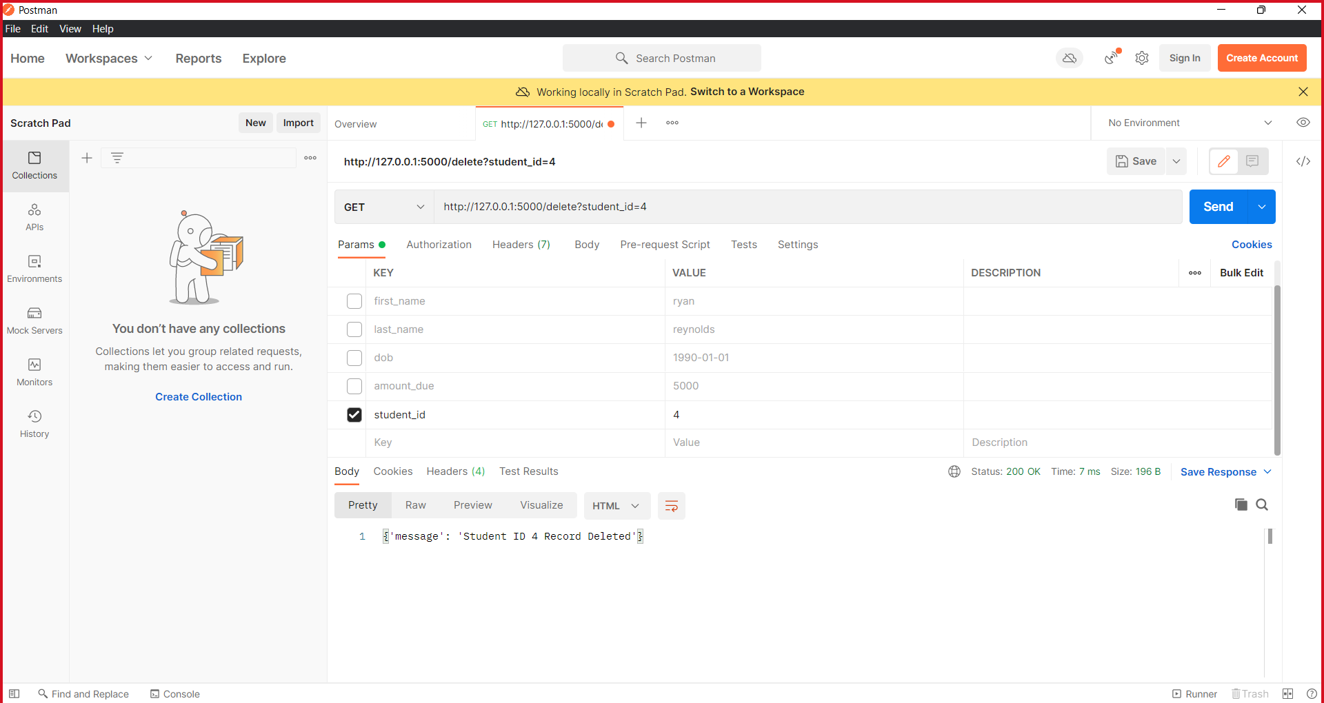
For Delete

Slide 7
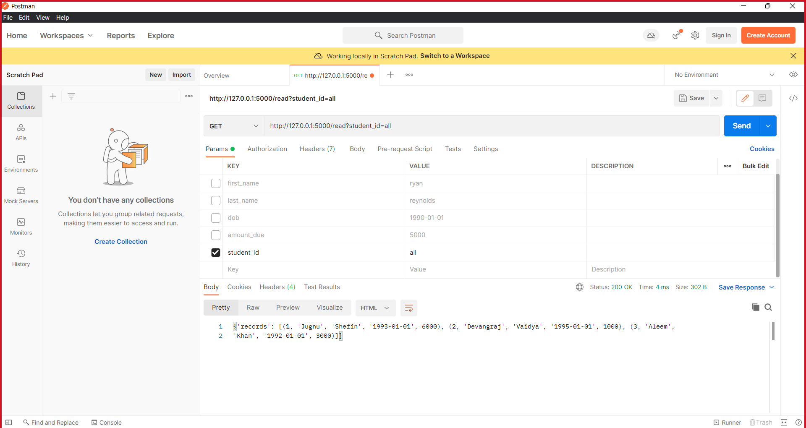
For Show all records

Slide 8
Collaboration plan and work division
TASKS | Jugnu | Devangraj | Aleemullah
Creating the flask code | ✓ | ✓ | ✓
Creating the database | ✓ |  | ✓
Creating the folder directory |  | ✓
Presentation | ✓ | ✓ | ✓

Slide 9
GITHUB Link
https://github.com/devangraj95/AIDI-2004-02-Assignment-3.git

